Slide 1
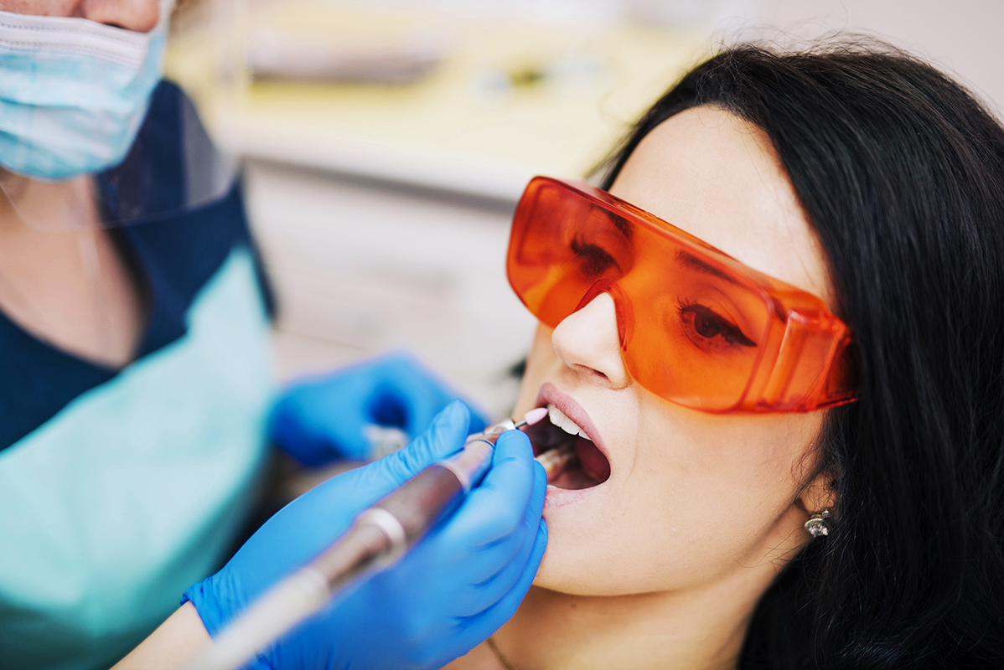
WHITEETH
Carla Deveaud Sánchez
Jezabel Esbrí Rodríguez
Evgeny Grachev
Yassmina Jebbour Maamri
Manuel Rocamora Valenti

Slide 2
CONTENT (lo de paréntesis se borra)
Who are we? (Roles)
What is our project about? (Context)
What do we want to get? (Goals and values)
Why did we want to do that or what innovations do we offer? (Innovation)
With what data? (Data)
How are we doing it? (Methodology)
When are we doing it? (Plan)
Who could be interested in our project results and how it could impact? (Impact)
Bibliography

Slide 3
Who are we?
With the aim of having a harmonious team where everything fits and works correctly, we decided to assign certain roles.
Our team roles:
Leader → Manuel
Doer → Yassmina
Thinker → Evgeny
Carers → Jezabel & Carla

Slide 4
2. What is our project about?
MERCURY
VENUS
Mercury is the closest planet to the Sun and the smallest one in the Solar System
Venus has a beautiful name and is the second planet from the Sun

Slide 5
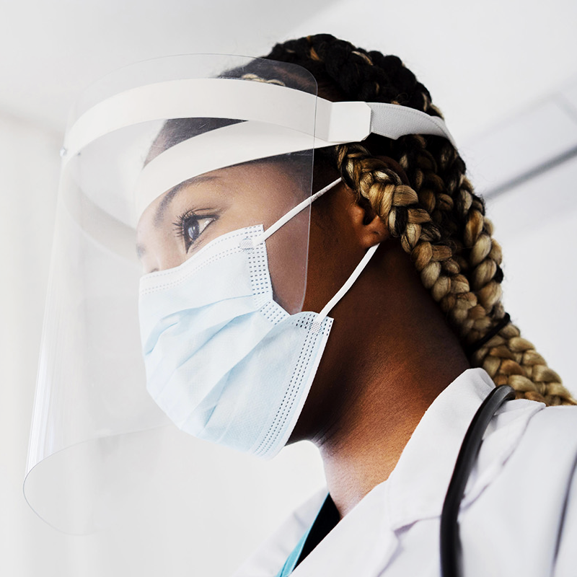
3. What do we want to get?
A
B
C
MARS
Despite being red, Mars is actually a cold place
JUPITER
It’s a gas giant and the biggest in the Solar System
MERCURY
It’s the closest planet to the Sun and the smallest one

Slide 6

4. Why did we want to do that or what innovations do we offer?
01
02
To predict how much time an intervention could last
Identifying risky interventions
We often experience delays of at least half an hour due to poor schedule organization or complications during interventions.
We could demonstrate that issues like high cholesterol or anemia can be determining factors.

Slide 7
5. With what data?
A
C
B
D
MERCURY
JUPITER
Mercury is the closest planet to the Sun
Jupiter is the biggest planet of them all
VENUS
MARS
Venus is the second planet from the Sun
Despite being red, Mars is actually a cold place

Slide 8
6. How are we doing it?
CRISP-DM (Cross-Industry Standard Process for Data Mining).

Slide 9
7. When are we doing it?
MISSION
VISION
You can describe the mission of your dental office here
You can describe the mission of your dental office here
You can describe the mission of your dental office here
You can describe the vision of your dental office here
You can describe the vision of your dental office here
You can describe the vision of your dental office here

Slide 10
8. Who could be interested in our project results and how it could impact?
25%
50%
65%
SATURN
MARS
VENUS
Saturn is a gas giant and has several rings
Despite being red, Mars is a cold place
Venus is the second planet from the Sun

Slide 11
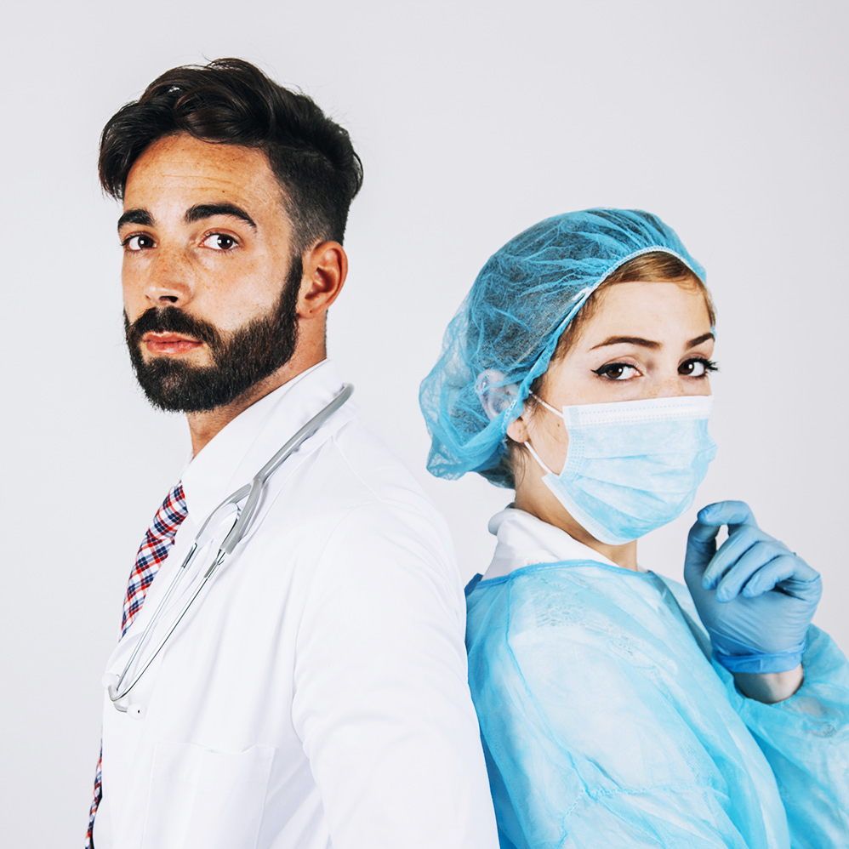
9. Bibliography.
EMMA MAYER
You can talk a bit about this person here
CHRIS JOHNSON
You can talk a bit about this person here

Slide 12
THANK YOU!
Do you have any questions?

